Slide 1

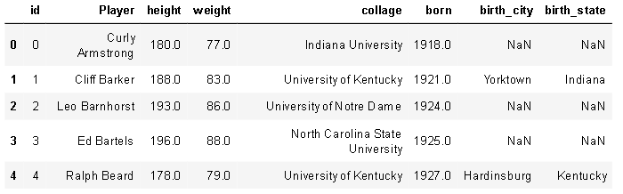
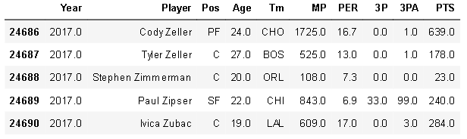
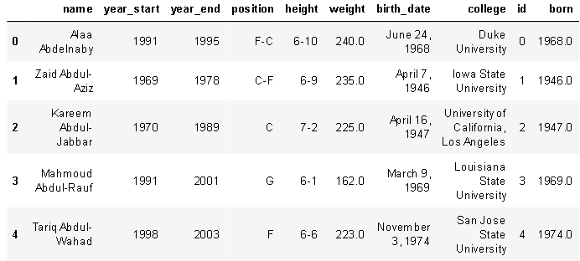
My dataset
  Players.csv
    8 columns 3921 rows
NBA Player stats since 1950
My reason for picking this
Some issues
  Duplicates
  Missing information
  Contradictive information
  Not updated since 2017
  Seasons_stats.csv
    53 columns, 24690 rows
  Player_data.csv
    8 columns, 4500 rows

Slide 2
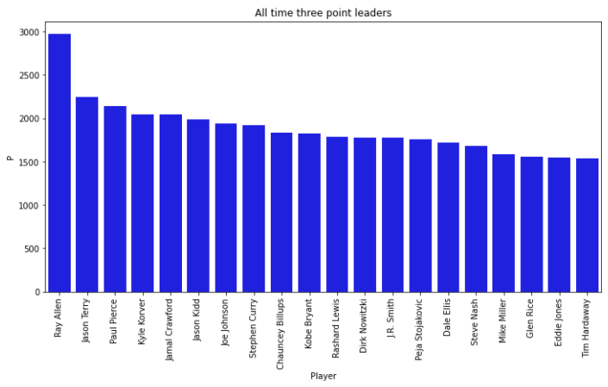
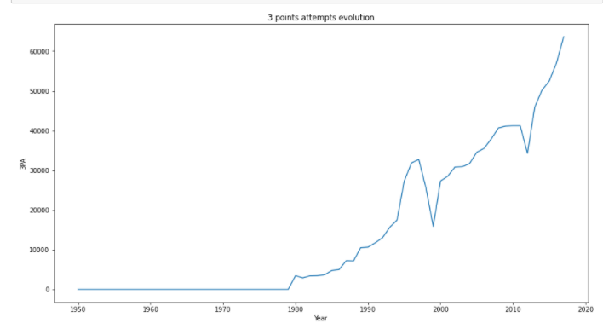
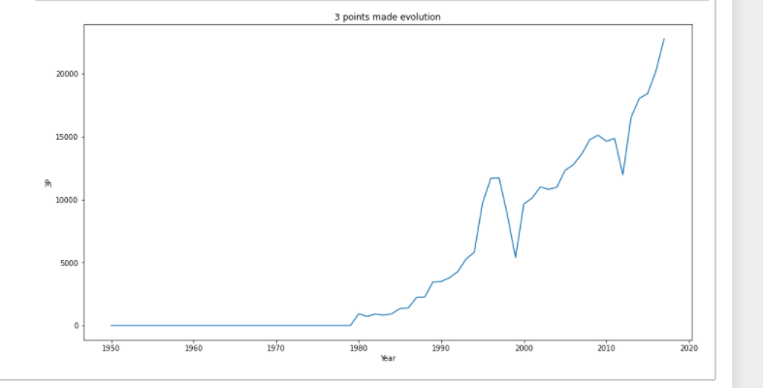
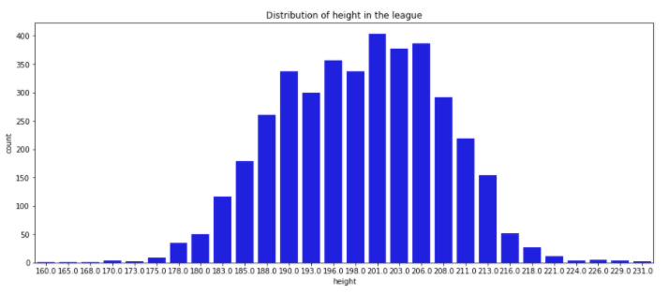
Models, Analysis and predictions

